Slide 1
SPONSORING PACKAGES
rapid.tech 3D
13 - 15 May 2025
Venue and organiser
Messe Erfurt GmbH
Gothaer Str. 34
99094 Erfurt

Slide 2
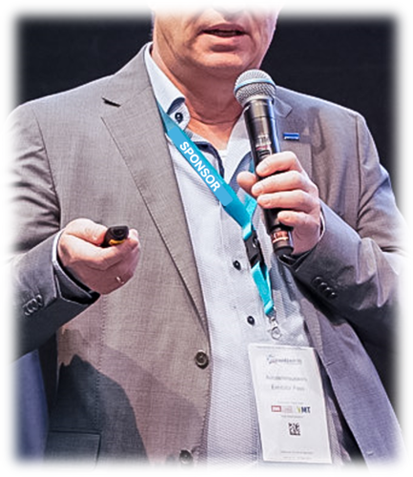
SPONSORING: LANYARDS
After registering on site, every visitor and congress participant will receive a personalised badge to wear around their neck with a lanyard. Take advantage of this exclusive advertising opportunity and secure at least 3,000 visual contacts! (Lanyards available up to one week before the start of the event.)
This package is ONLY available once!
EXCLUSIVE
EUR 2,500.00
Excl. VAT.
Advertising material is provided by the sponsor

Slide 3
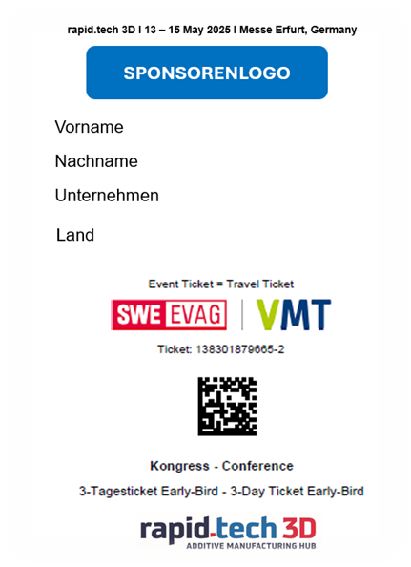
SPONSORING: TICKETING
Your logo will appear prominently on all TICKETS and exhibitor passes, in our ticket shop and of course on our homepage.
This package is ONLY available once!
EXCLUSIVE
EUR 2,000.00
Excl. VAT.

Slide 4
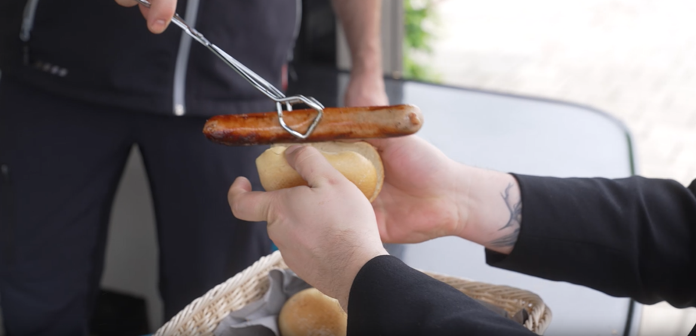
SPONSORING: WELCOME BBQ
Put your company in the spotlight as a sponsor of the Welcome BBQ on the evening before the first day of the event and give the AM community a warm welcome to the Erfurt exhibition centre on 12 May 2025.
Mention in the invitation
Placement of table set-ups with reference to sponsor
Placement of roll-ups and banners (own production by sponsor)
Distribution of napkins of the sponsor (own production by sponsor)
This package is ONLY available once!
EXCLUSIVE
EUR 2,000.00
Excl. VAT.
Advertising material is provided by the sponsor

Slide 5
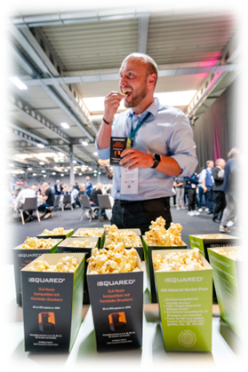
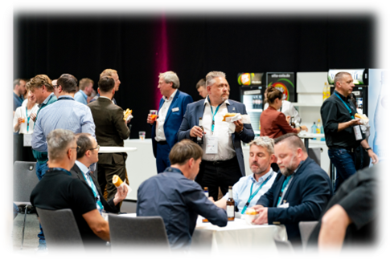
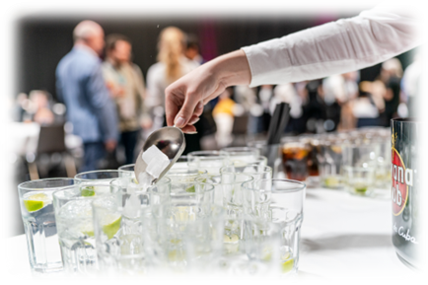
SPONSORING: AFTER WORK
We will bring the first day of the event to a relaxed close - your chance to perform! At the After Work on 13 May 2025, we will welcome all exhibitors, speakers, congress participants and partners in Hall 2 directly after the end of the event at 6 p.m.
Mention in the invitation
Setting up of advertising banners/advertising material
Greeting at the opening
This package is ONLY available once!
EXCLUSIVE
EUR 3,000.00
Excl. VAT.
Advertising material is provided by the sponsor

Slide 6
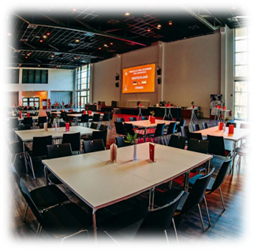
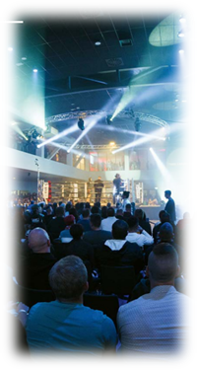
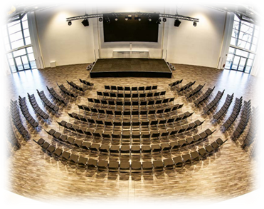
SPONSORING: EVENING RECEPTION
Date: 14 May 2025, entrance: from 6 p.m., start: 6.30 p.m.
Location: Arena Erfurt
Content of the sponsorship package:
Your presentation during our networking evening for around 350 exhibitors,
speakers, congress participants and partners include the following services:
Sponsoring welcome drink
Personal give-away for all participants possible
Welcome speech in the evening program
Beach flags or roll-ups in the entrance and on stage
Logo presentation on the screen (alternating with other logos and pictures of the event)
This package is ONLY available once!
EUR 7,000.00
Excl. VAT.
Advertising material is provided by the sponsor

Slide 7
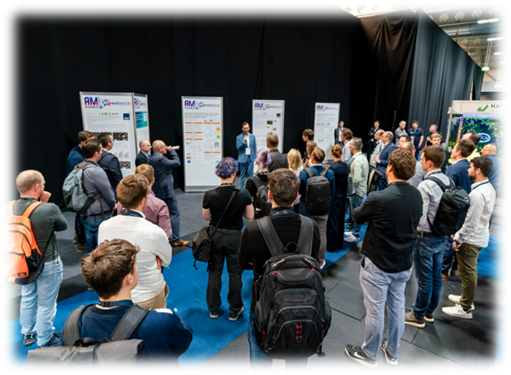
SPONSORING: AM SCIENCE CORNER
Secure exclusive attention for 3 days and become a sponsor of the Science Corner! You will give a welcome speech at the opening of the Poster Sessions. Your logo will appear on the posters as well as regular logo displays on the monitors in Hall 2 and on our homepage. Placement of your roll-ups, beach flags, etc. and display of your marketing material in the Science Corner area.
This package is ONLY available once!
EXCLUSIVE
EUR 2,500.00
Excl. VAT.
Advertising material is provided by the sponsor

Slide 8
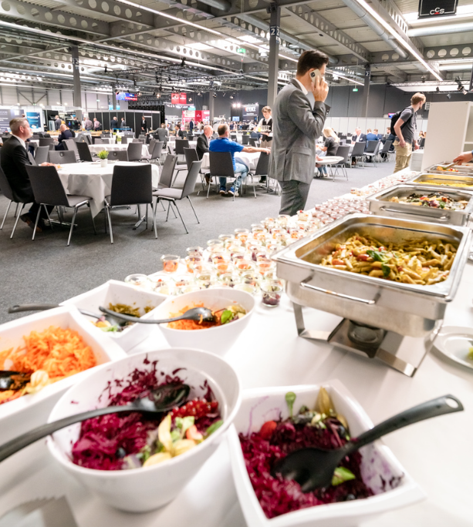
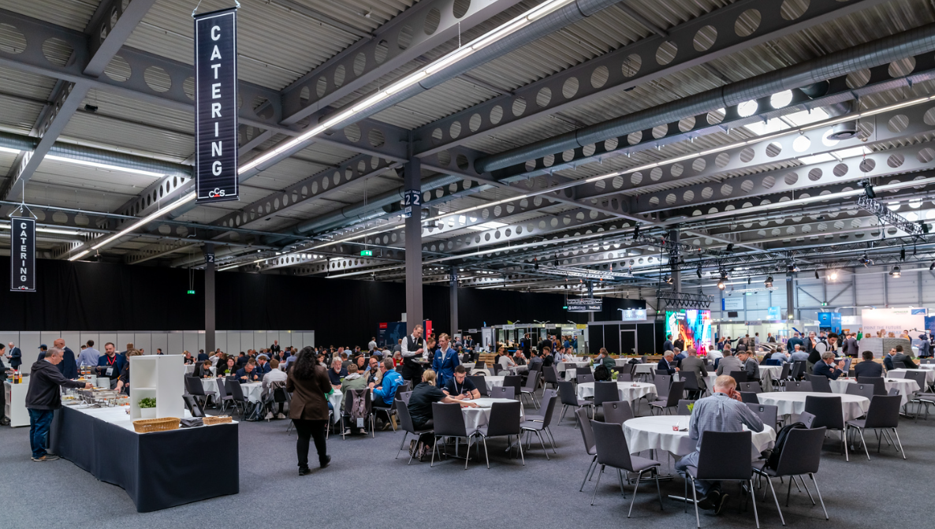
SPONSORING: CATERING & CAFE AREA
All exhibitors, congress participants and speakers are entitled to lunch catering in Hall 2. Visitors to the exhibition can use the café in the hall. Equip the catering area for the participants:
Table set-up with reference to sponsor, placement of roll-ups and banners (own production by sponsor)
Distribution of napkins and coffee cups of the sponsor (own production by sponsor)
This package is ONLY available once!
EUR 3,000.00
Excl. VAT.
Advertising material is provided by the sponsor

Slide 9
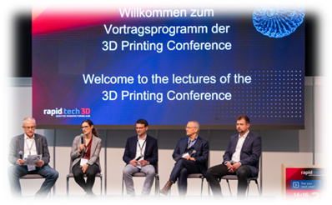
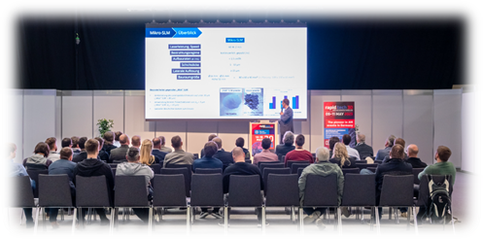
SPONSORING: 3D PRINTING CONFERENCE STAGE
We also have a varied program of talks in Hall 2 for all trade fair visitors who are not attending the congress in the CongressCenter. Secure exclusive attention for 3 days and become a sponsor of the lecture stage! This includes regular logo insertions as well as the placement of your roll-ups, beach flags, etc. and the display of your marketing material. In addition, you will have the opportunity to speak twice for your company.
This package is ONLY available once!
EUR 3,000.00
Excl. VAT.
Advertising material is provided by the sponsor

Slide 10
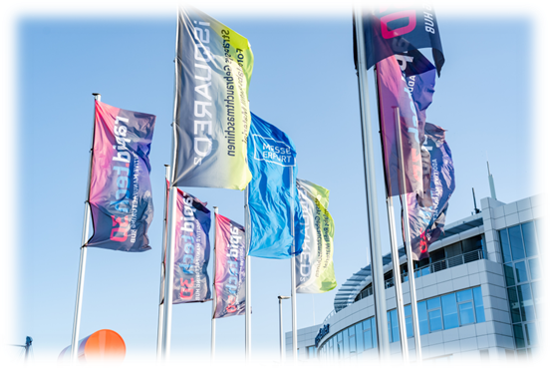
SPONSORING: DISPLAYS & FLAGS
Projection of your company logo or video on the LCD screen above the entrance to the CongressCentre and the trade fair as well as on the displays in the entrance area and in Hall 2 on all three days of the event. 2 flags on the exhibition forecourt and 2 flags at the east car park.
This package is ONLY available 3 times!
EUR 1,000.00
Excl. VAT.
Advertising material is provided by the sponsor

Slide 11
SPONSORED SPEAKING SLOT
Even if you are not an exhibitor at rapid.tech 3D 2025, we will give you the opportunity to present a talk on our Exhibitor Stage. Your innovation will meet our expert audience. We also have a varied daily program of presentations in Hall 2 for all visitors who are not taking part in the specialist congress program. Secure your speaking slot on our Printing Conference stage! Regular logo insertions are just as much a part of the program as the logo insertion on our homepage.
EUR 800.00
Excl. VAT.

Slide 12
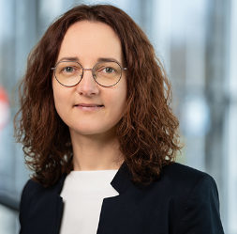
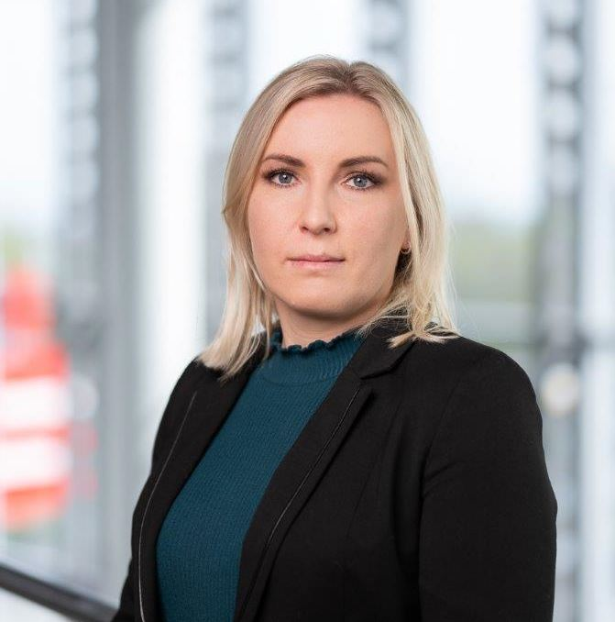
We are happy to help you
We are giving additive technologies a stage.
rapid.tech 3D will be your success:
Industry-specific knowledge exchange with users and developers
Generate valuable leads
New contacts during our networking events
AM exhibitors with the latest industry trends
Manuela Braune
+49 361 400 1730
m.braune@messe-erfurt.de
Valentina Kern
+49 361 400 1620
v.kern@messe-erfurt.de

